Slide 1
Defense Acquisition Workforce
Key Information
OVERALL
As of FY20Q3 (30 June 2020)

Slide 2
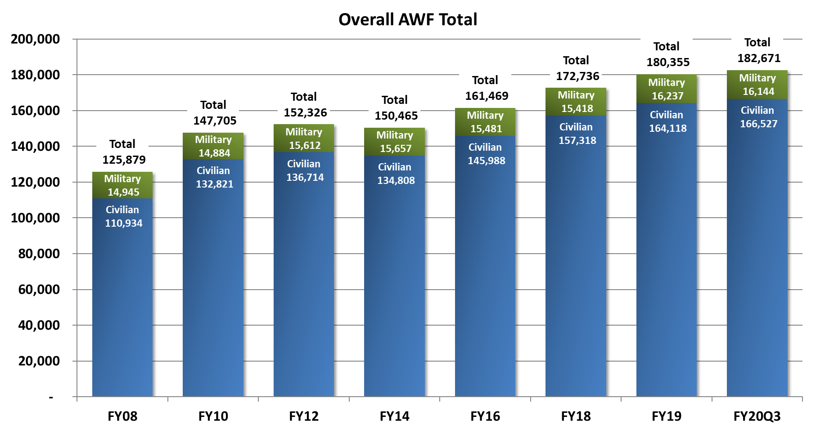
AWF – Annual Historical Workforce Size
FY08– FY20Q3
A&S DataMart as of 30 June 2020
Notes:
2

Slide 3
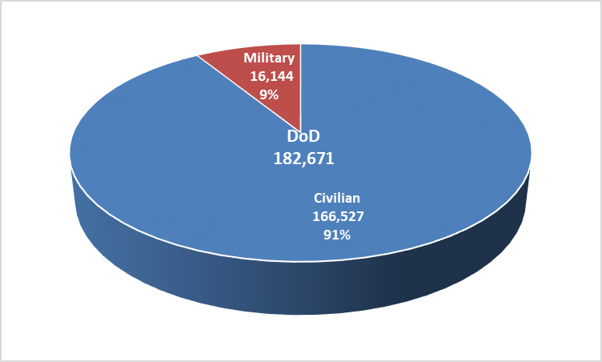
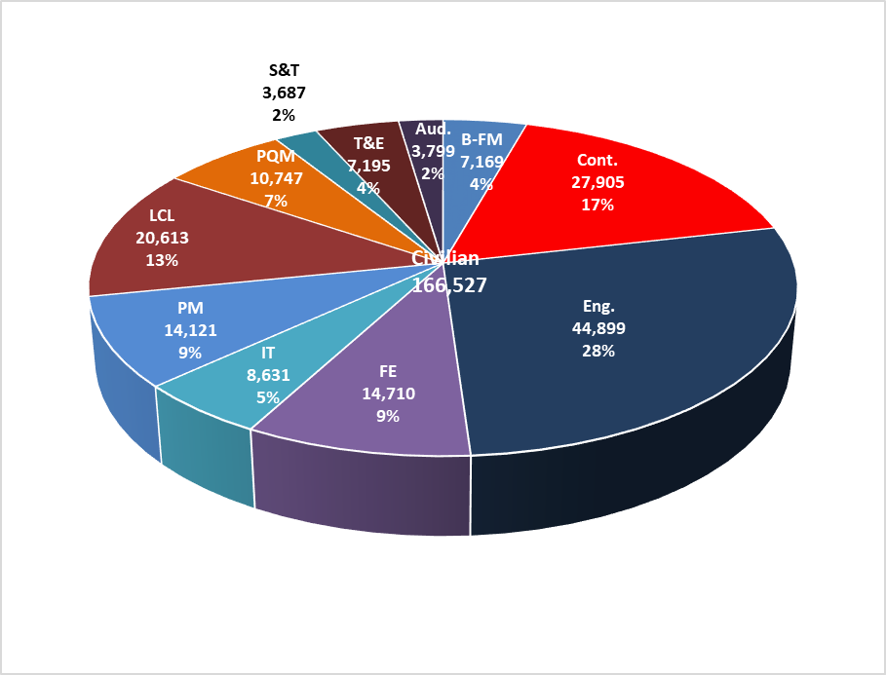
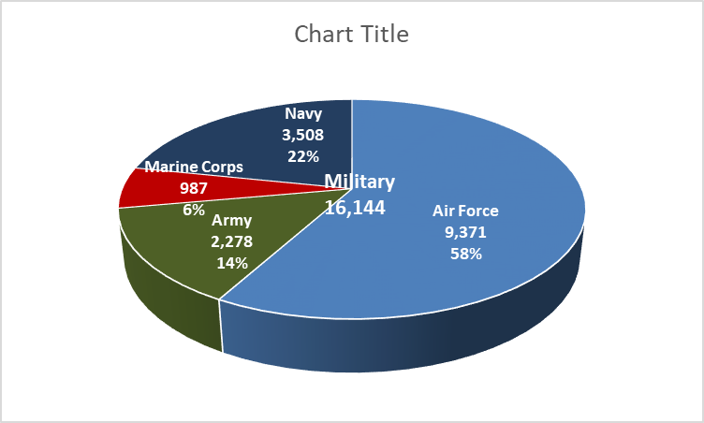
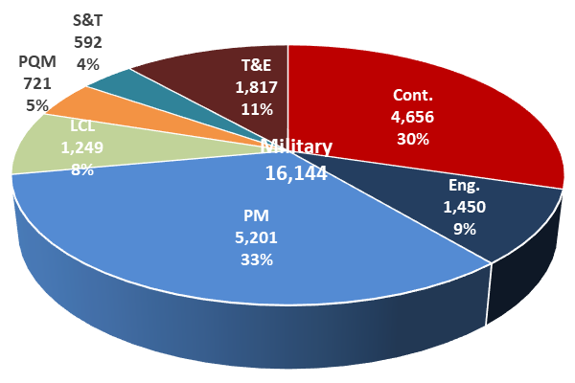
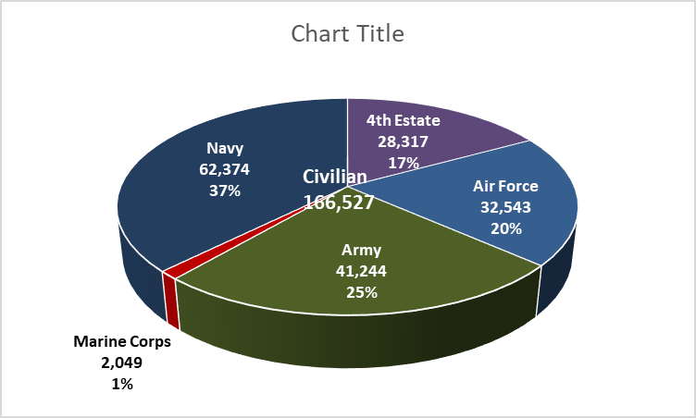
AWF – Military and Civilian
By Component and Career Field
A&S DataMart as of 30 June 2020
Notes:
3

Slide 4
AWF Size by Component and Career Field
A&S DataMart as of 30 June 2020

Slide 5
AWF Historical Size Detail by Component (Civilian & Military)
A&S DataMart as of 30 June 2020

Slide 6
AWF Historical Size Detail by Component (Civilian)
A&S DataMart as of 30 June 2020

Slide 7
AWF Historical Size Detail by Component (Military)
A&S DataMart as of 30 June 2020

Slide 8
AWF Historical Size Detail by Career Field (Civilian and Military)
A&S DataMart as of 30 June 2020

Slide 9
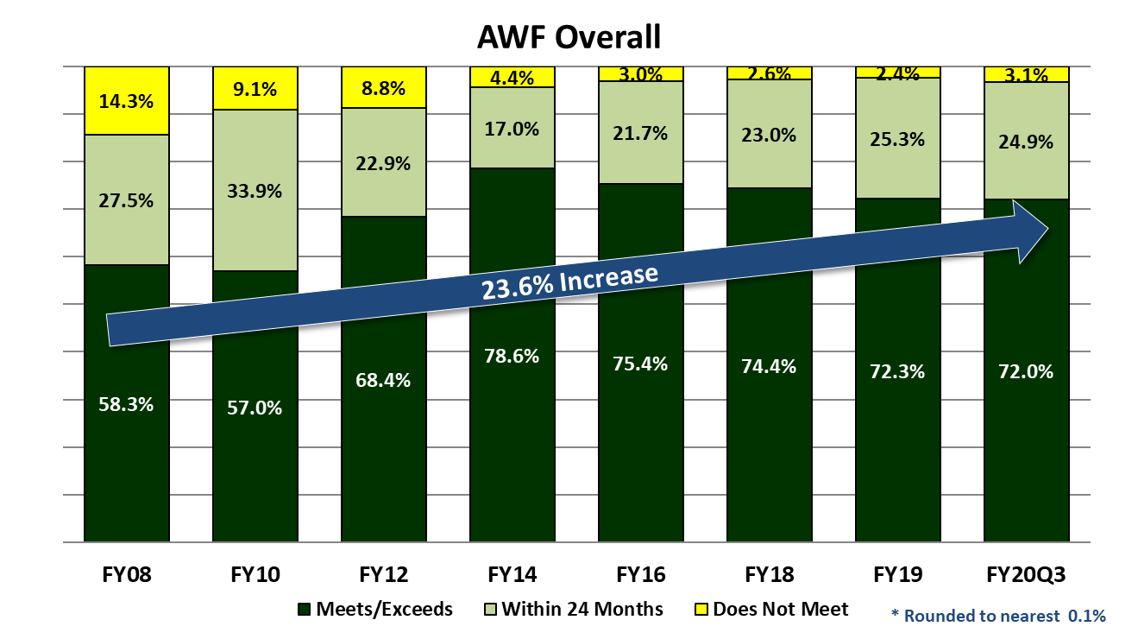
AWF Historical DAWIA Certification
FY08 – FY20Q3
A&S DataMart as of 30 June 2020

Slide 10
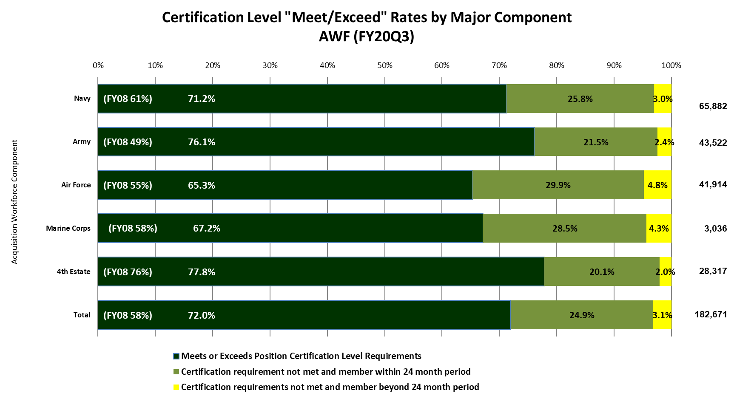
AWF DAWIA Certification by Major Component
A&S DataMart as of 30 June 2020
Notes:
Shows only components with over 400 personnel.

Slide 11
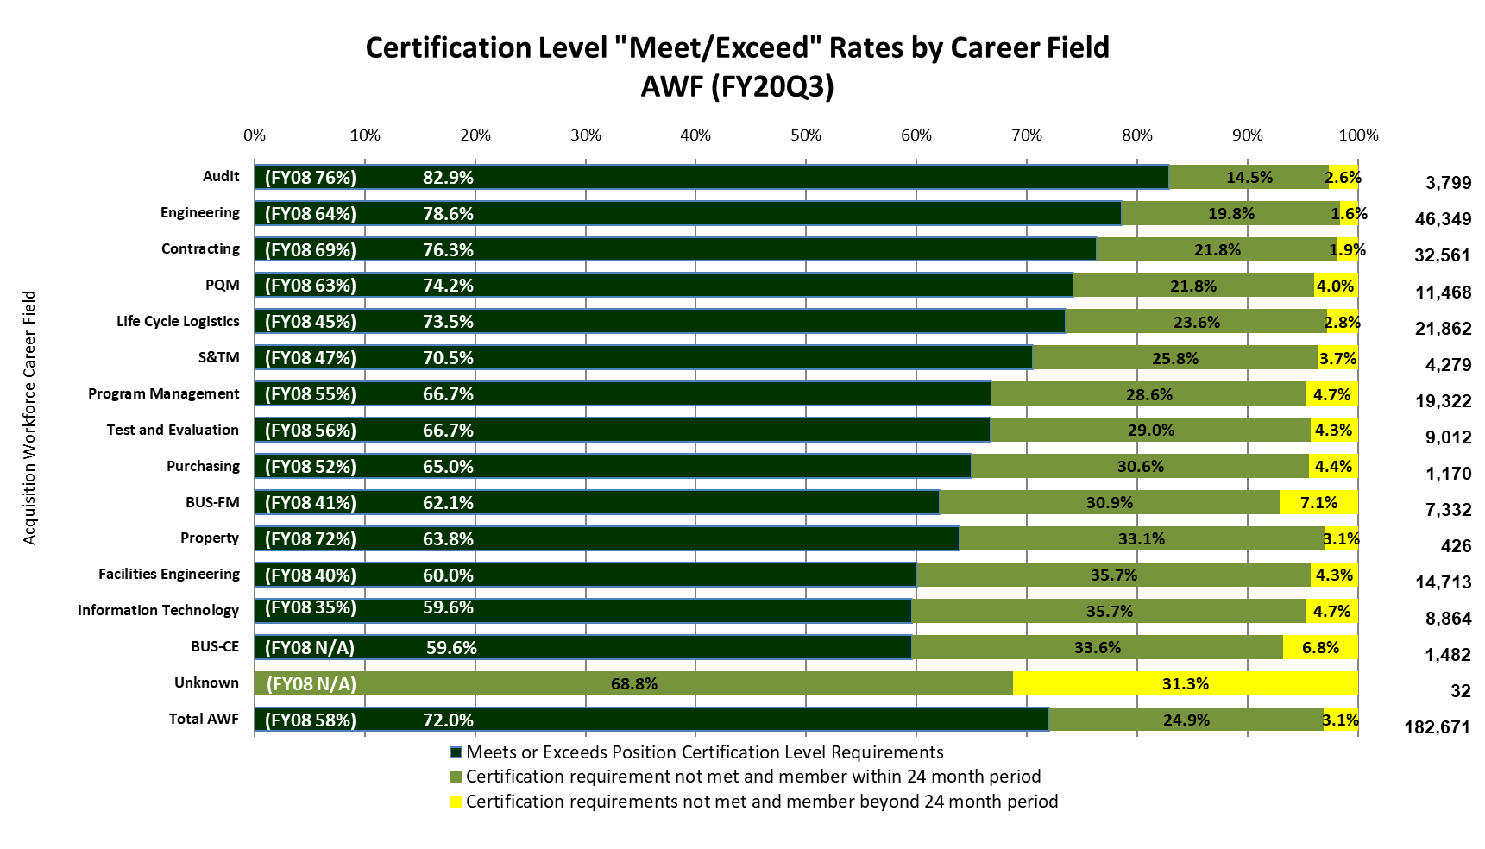
AWF DAWIA Certification by Career Field
A&S DataMart as of 30 June 2020

Slide 12
AWF DAWIA Certification
A&S DataMart as of 31 March 2020

Slide 13
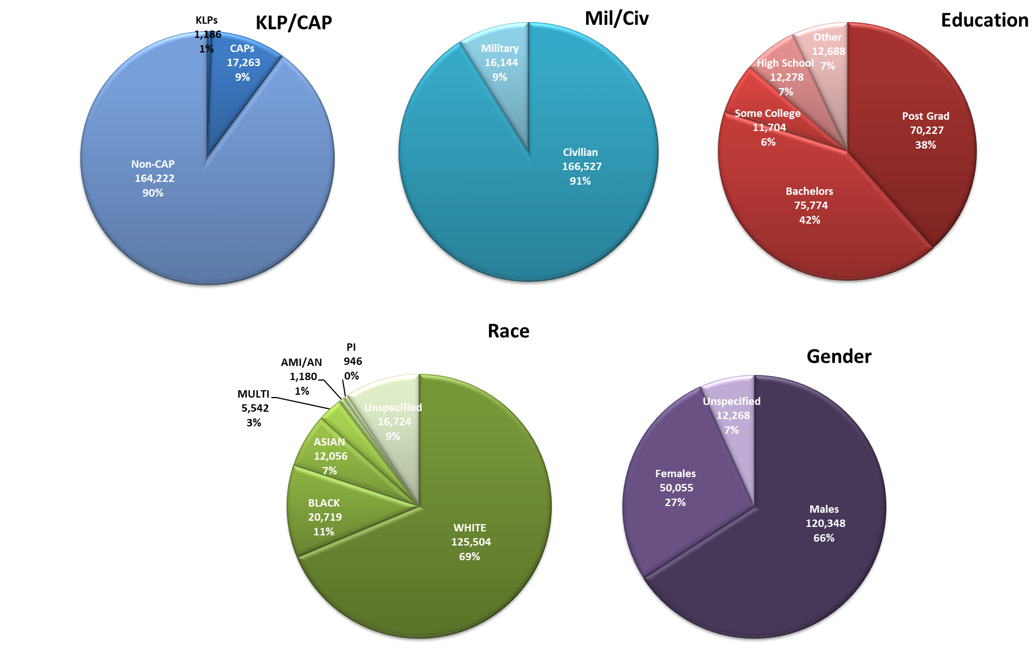
AWF Demographics
A&S DataMart as of 31 Mar 2020

Slide 14
RAND NDRI Forces and Resources
Policy Center Data
Retirement, Gains/Losses Slides
FY20Q3

Slide 15
Fact Sheet
RAND NDRI (as of 30 June 2020)

Slide 16
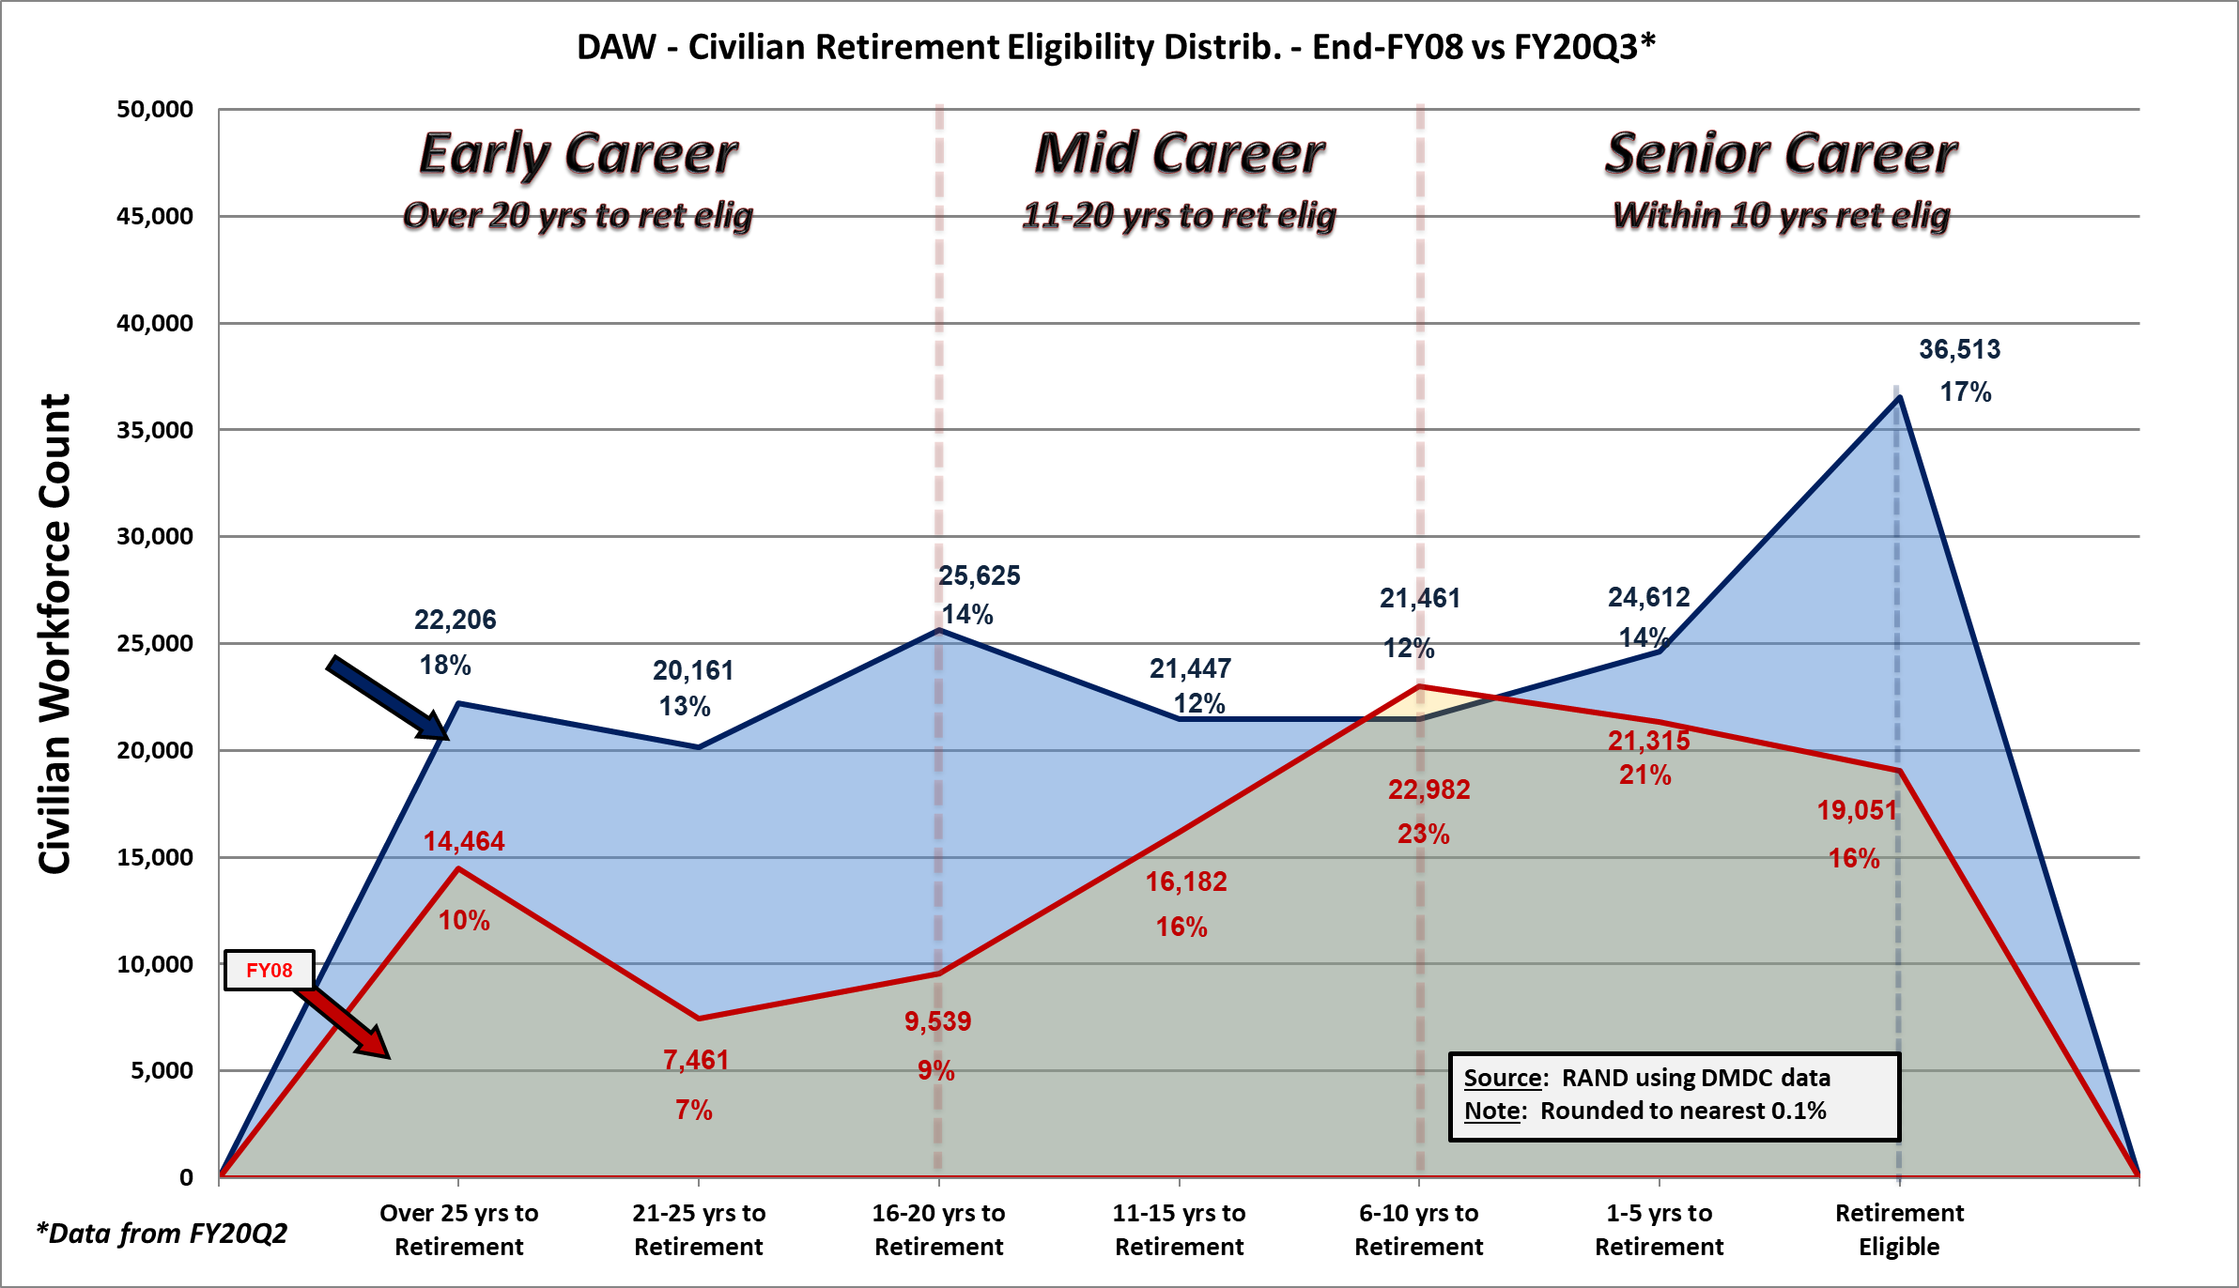

Overall Civilian Retirement Eligibility
Distribution – FY08/FY20Q3
RAND NDRI (as of 30 June 2020)

Slide 17

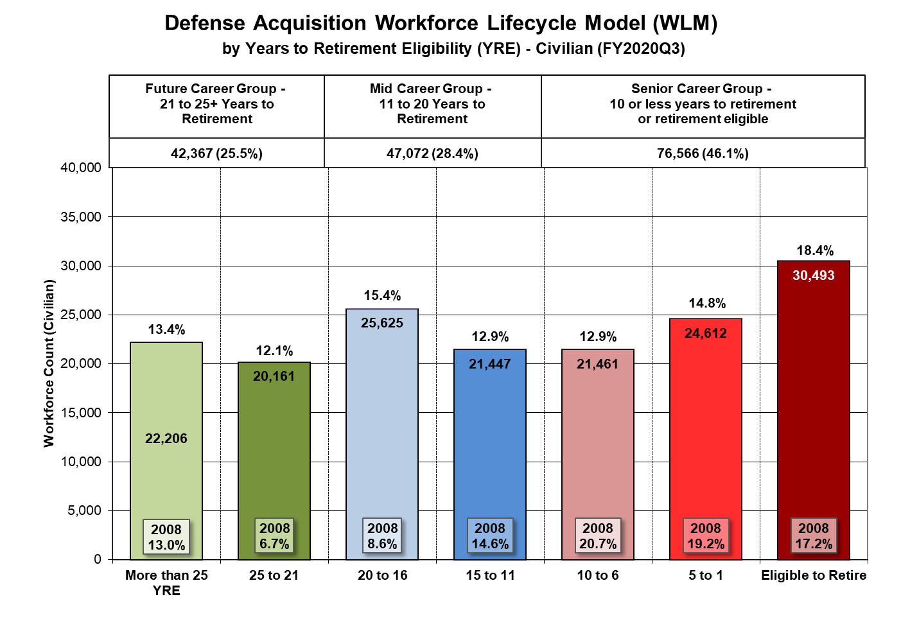
Workforce Lifecycle Model by YRE
RAND NDRI (as of 30 June 2020)

Slide 18
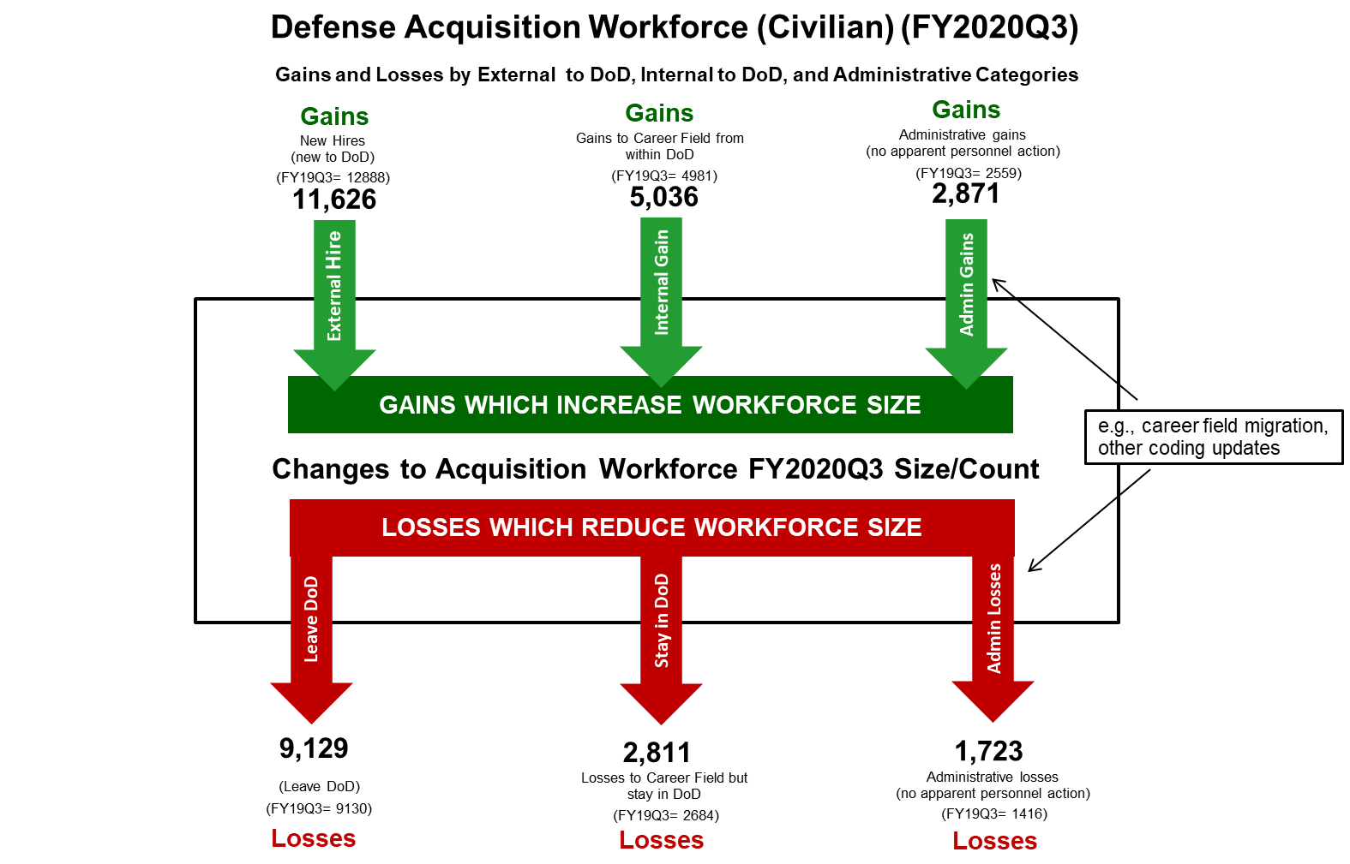
Gains/Losses – New Hires
Internal/External, Administrative
RAND NDRI (as of 30 June 2020)

Slide 19

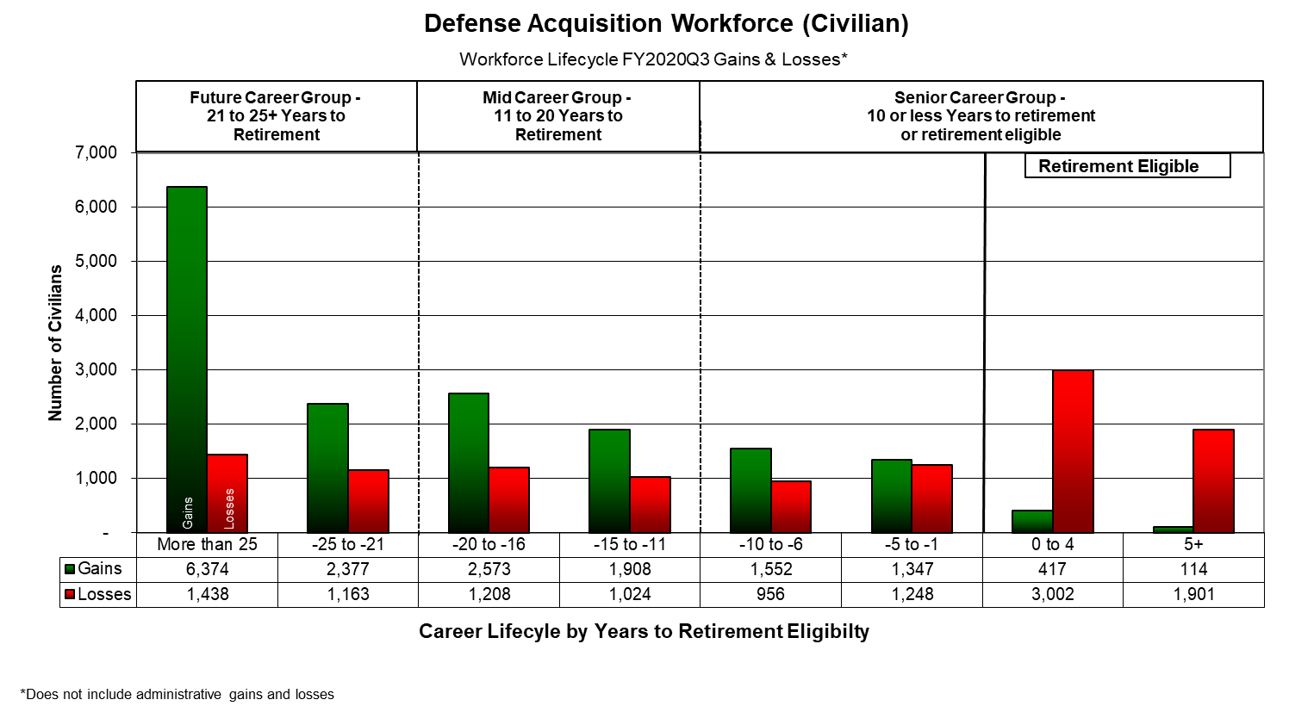
RAND NDRI (as of 30 June 2020)

Slide 20
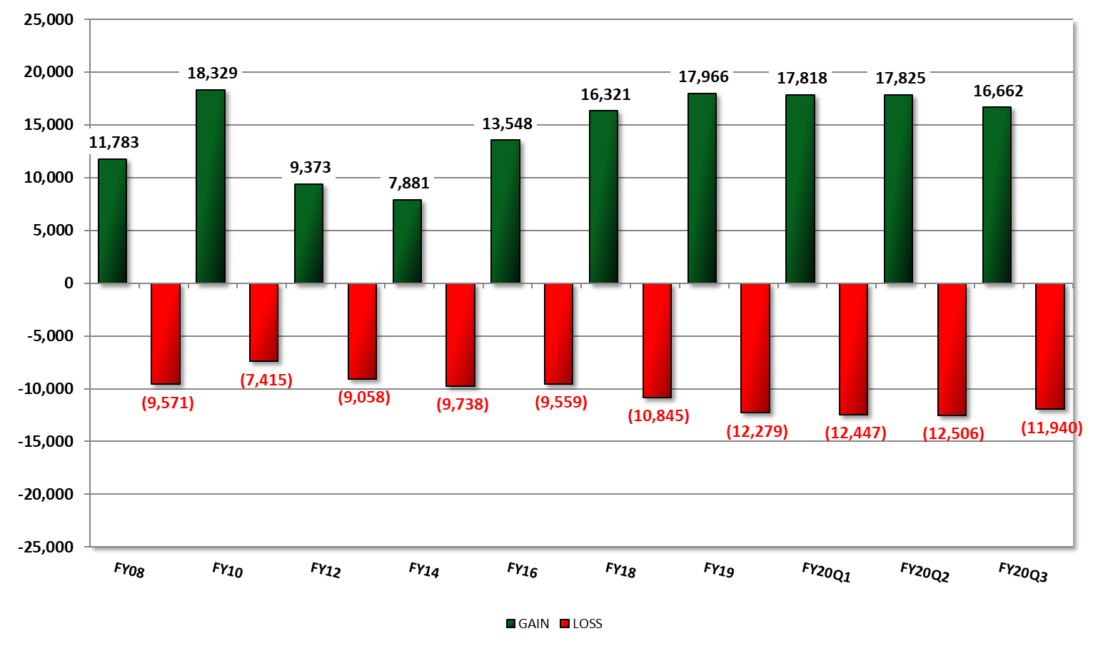
Historical Gains and Losses
FY08 – FY20Q3
RAND NDRI (as of 31 March 2020)

Slide 21
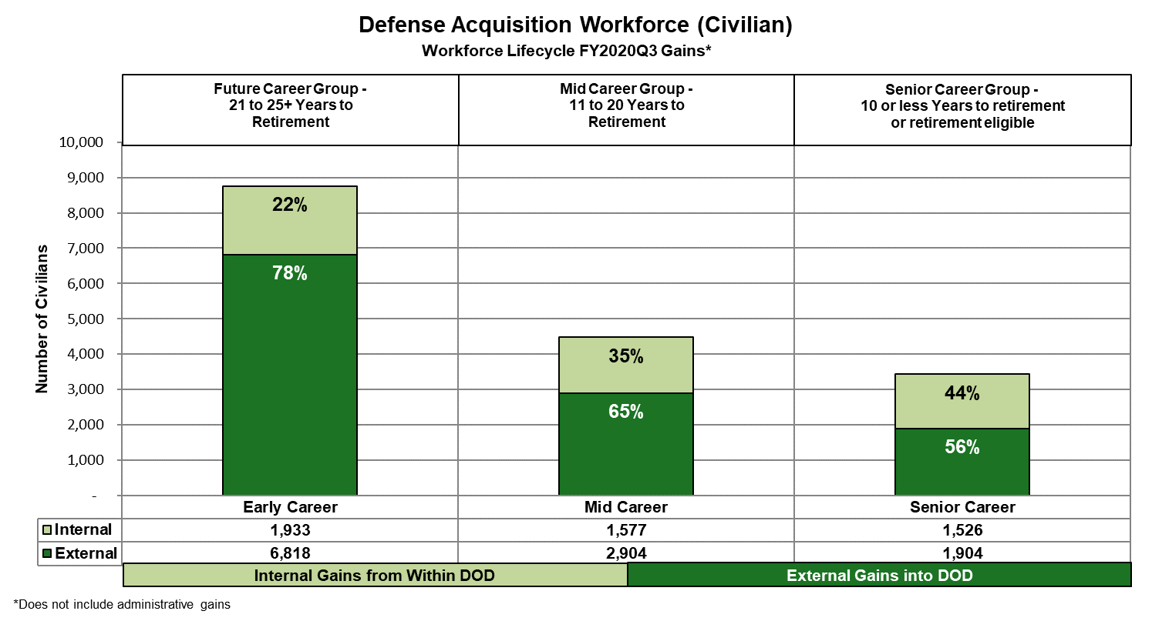
Internal/External Gains % by Career Group
RAND NDRI (as of 31 March 2020)

Slide 22
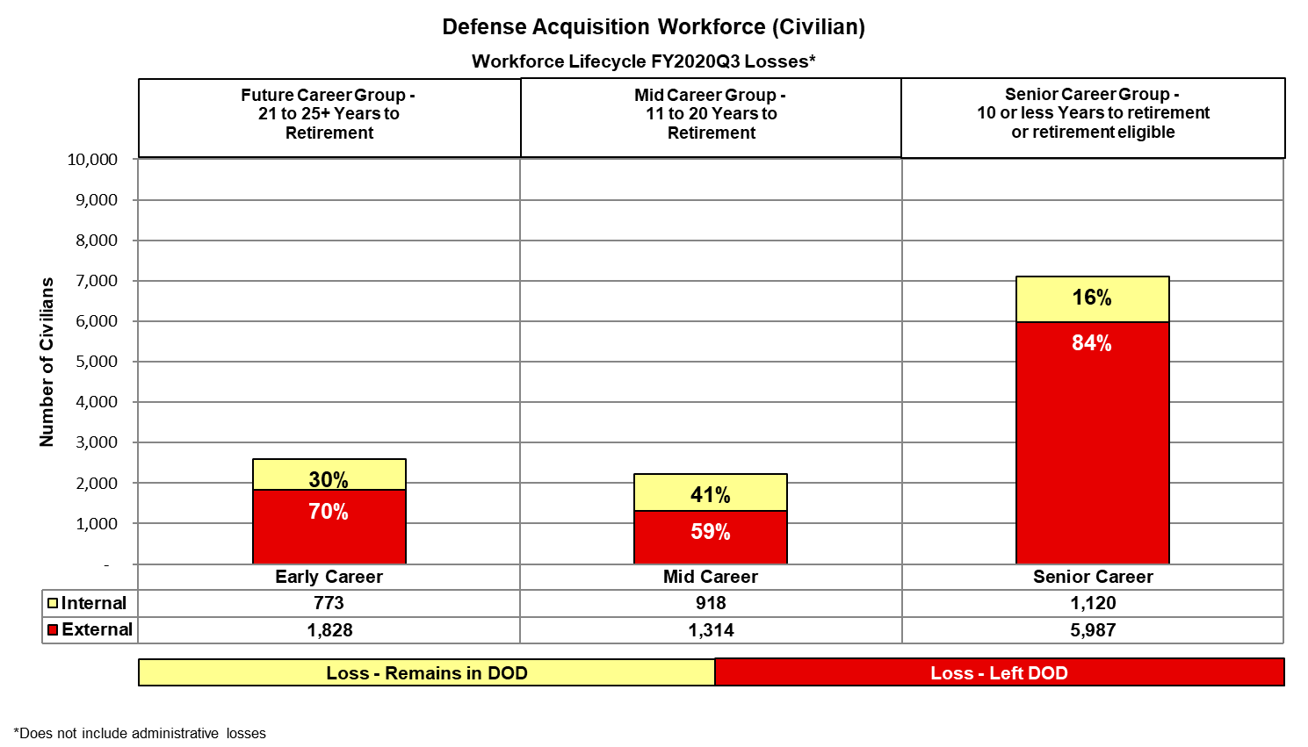
Internal/External Loss % by Career Group
RAND NDRI (as of 31 March 2020)

Slide 23
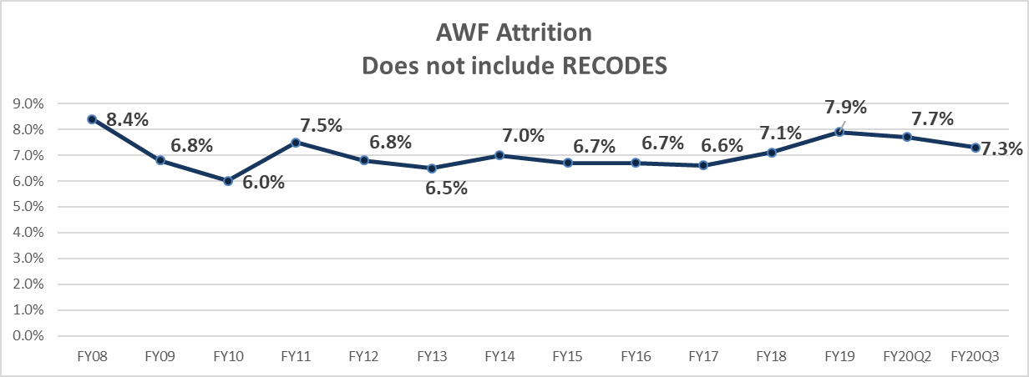
Annual Attrition Rates
*FY19 attrition rate is from the end of FY18Q4 through FY19Q2
RAND NDRI (as of 31 March 2020)

Slide 24
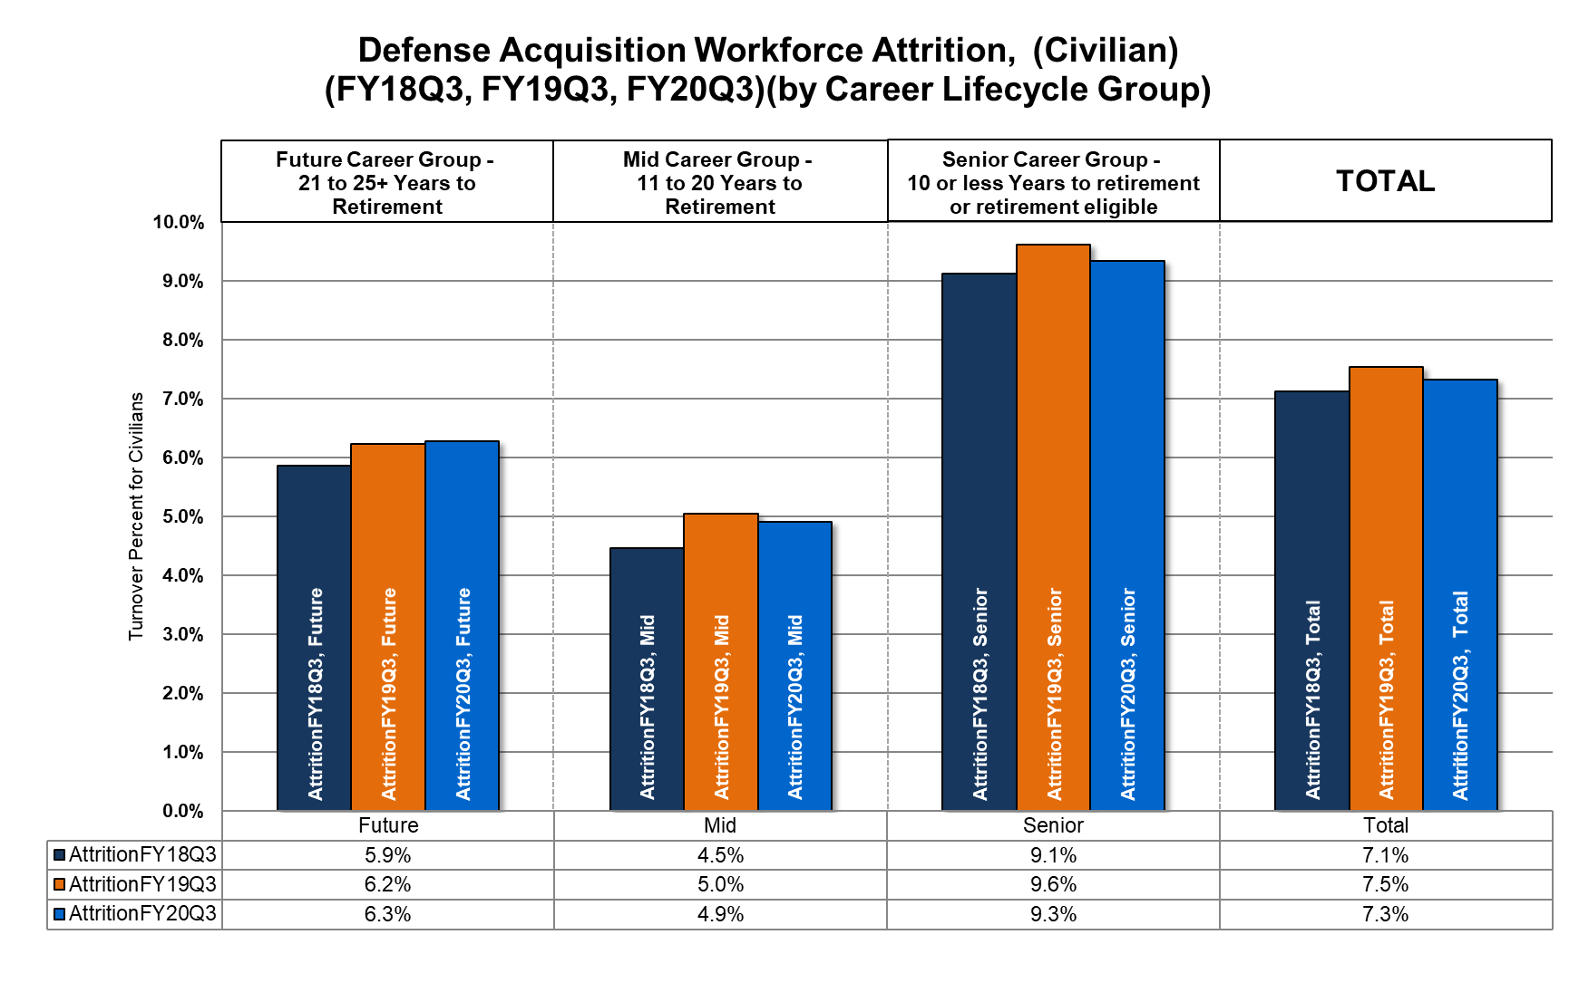
Attrition Rates by Career Group
RAND NDRI (as of 30 June 2020)

Slide 25
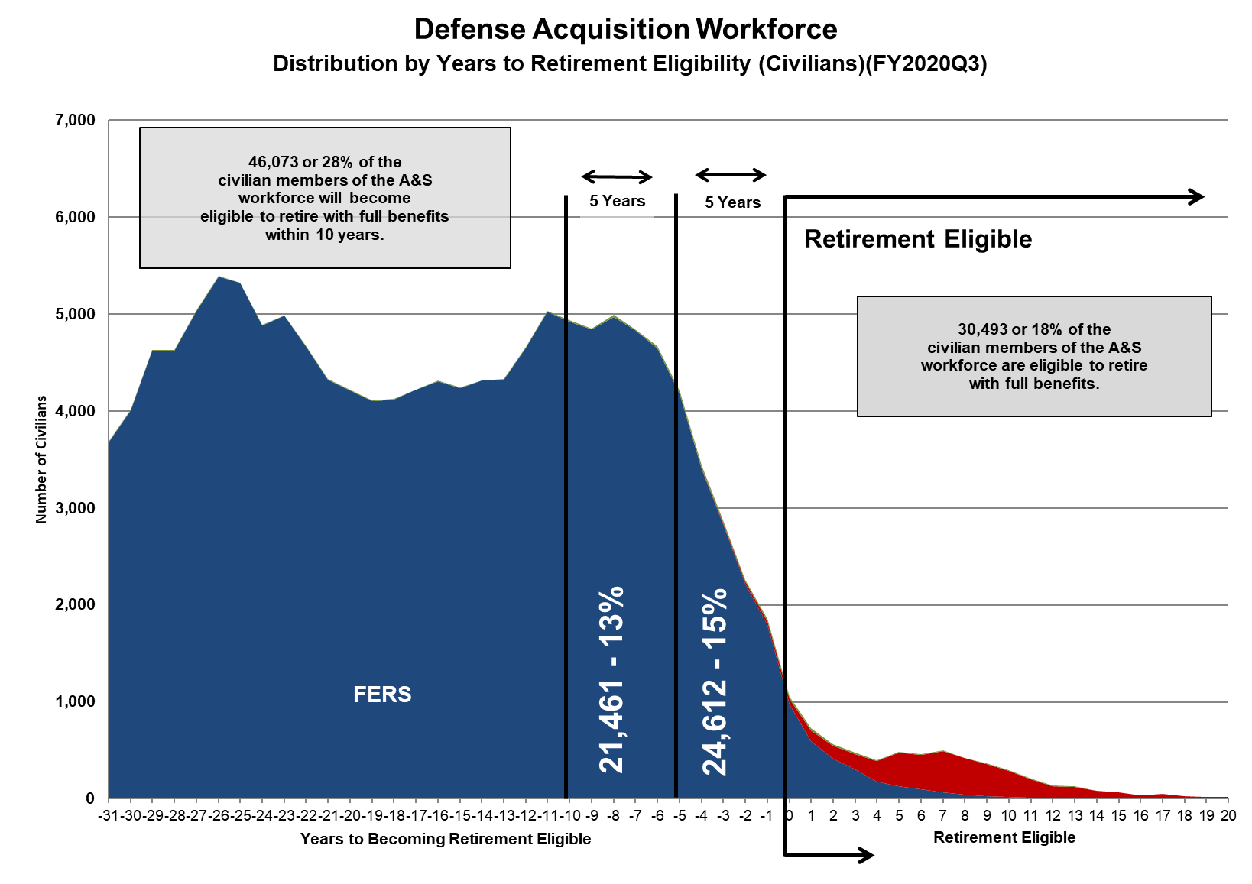
Civilian Distribution by Years to Retirement Eligibility
RAND NDRI (as of 30 June 2020)

