Slide 1
Defense Acquisition Workforce
Key Information
Business- Cost Estimating
As of FY20Q3 (30 June 2020)

Slide 2
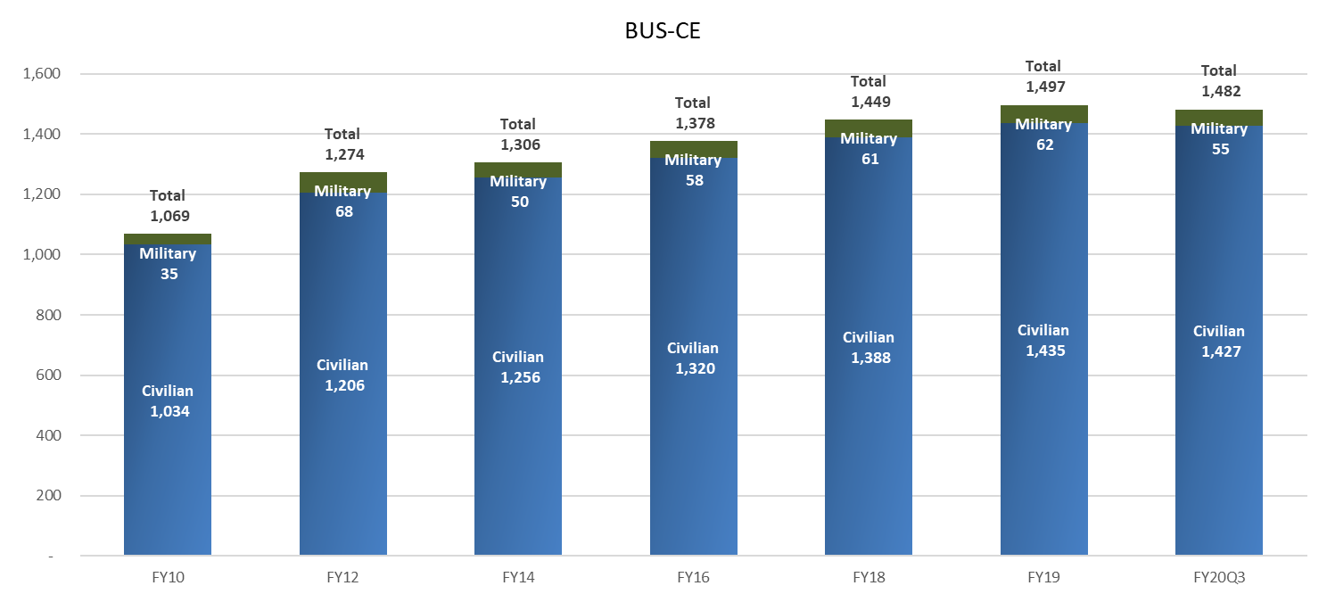
Total Historic Workforce
Data Source: A&S DataMart as of 30 June 2020

Slide 3
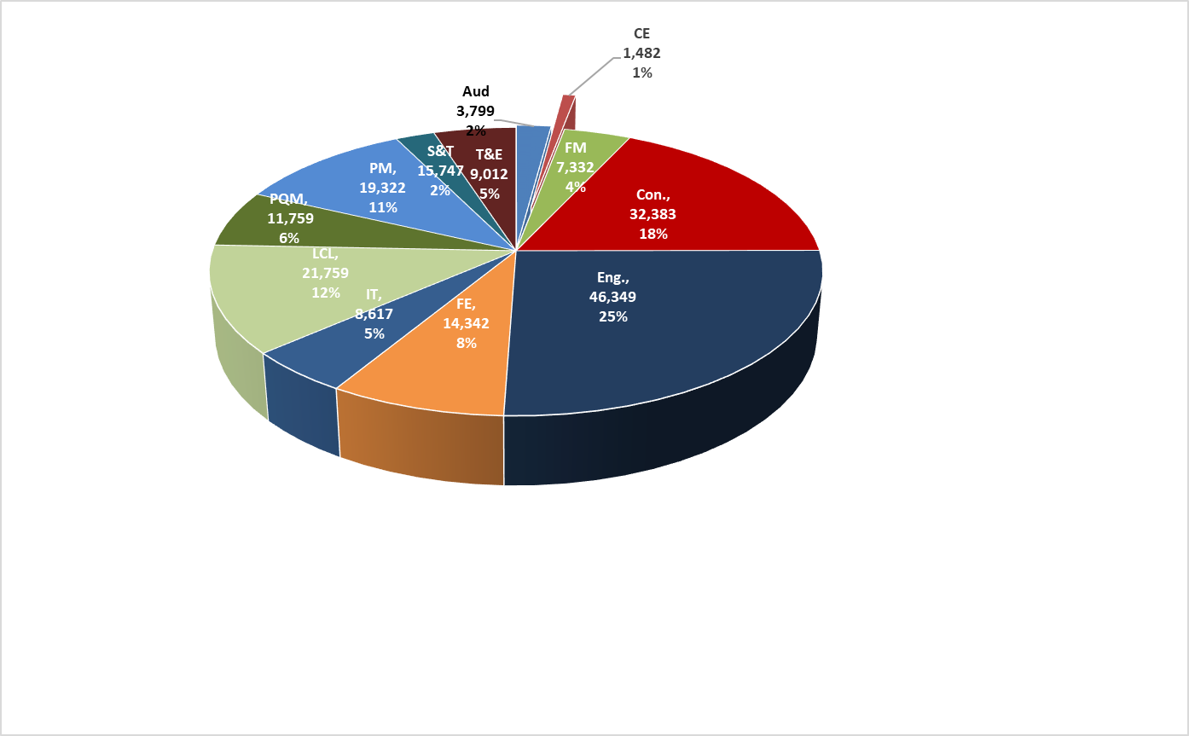
AWF by Component and Career Field
Data Source: A&S DataMart as of 30 June 2020

Slide 4
Business-CE Workforce Annual Historical Size by Component FY08 – FY20
Data Source: A&S DataMart as of 30 June 2020

Slide 5
Business-CE Workforce Annual Historical Size by Component (Quarterly)
Data Source: A&S DataMart as of 30 June 2020

Slide 6
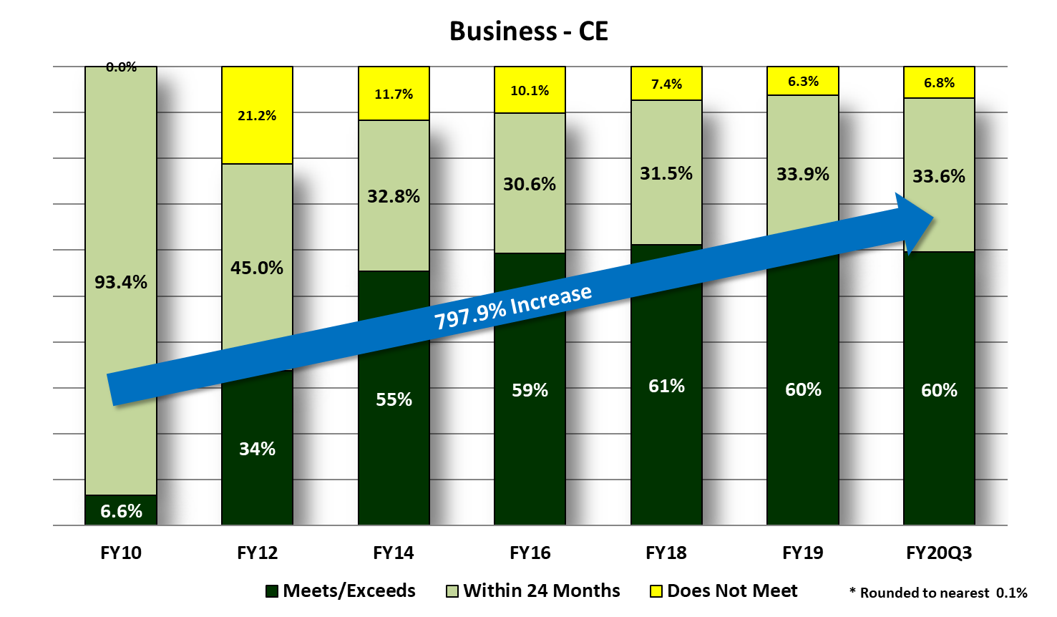
Business - CE Historical DAWIA
Certification FY10 – FY20Q3
Data Source: A&S DataMart as of 30 June 2020

Slide 7
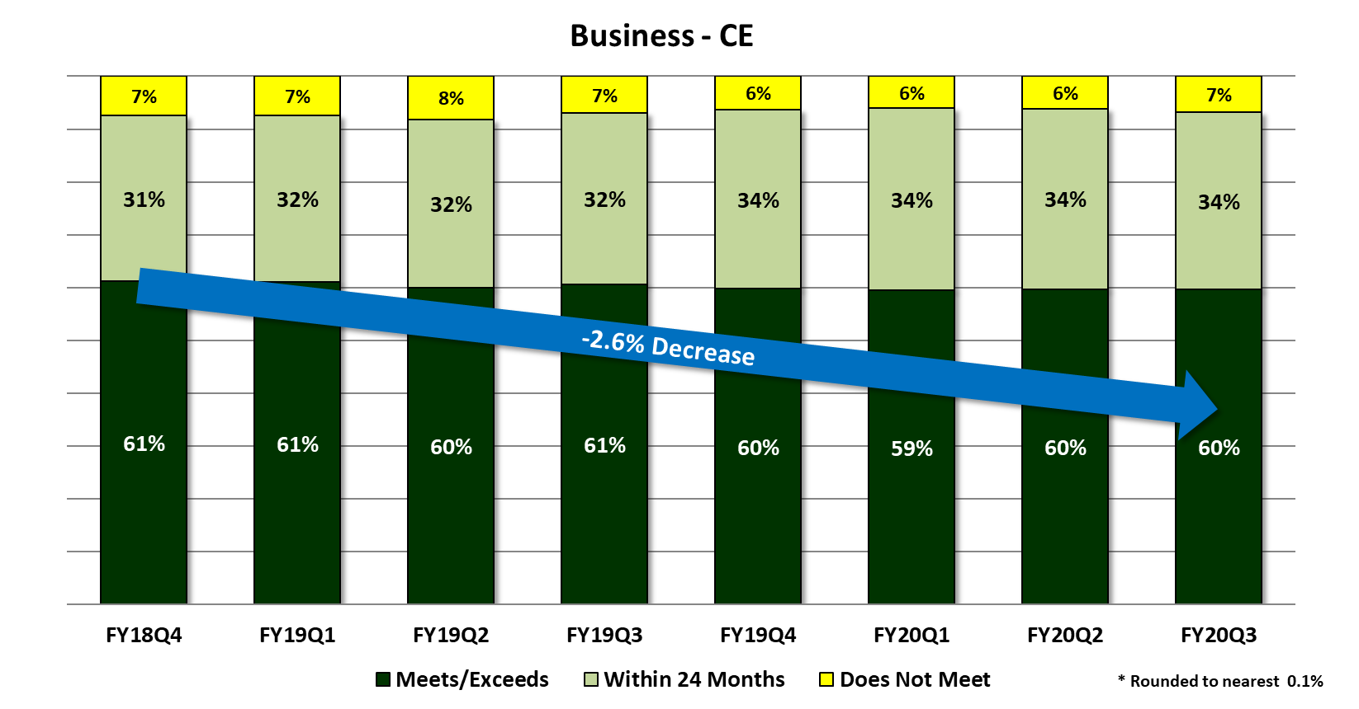
Business – CE Historical (Quarterly) DAWIA
Certification
Data Source: A&S DataMart as of 30 June 2020

Slide 8
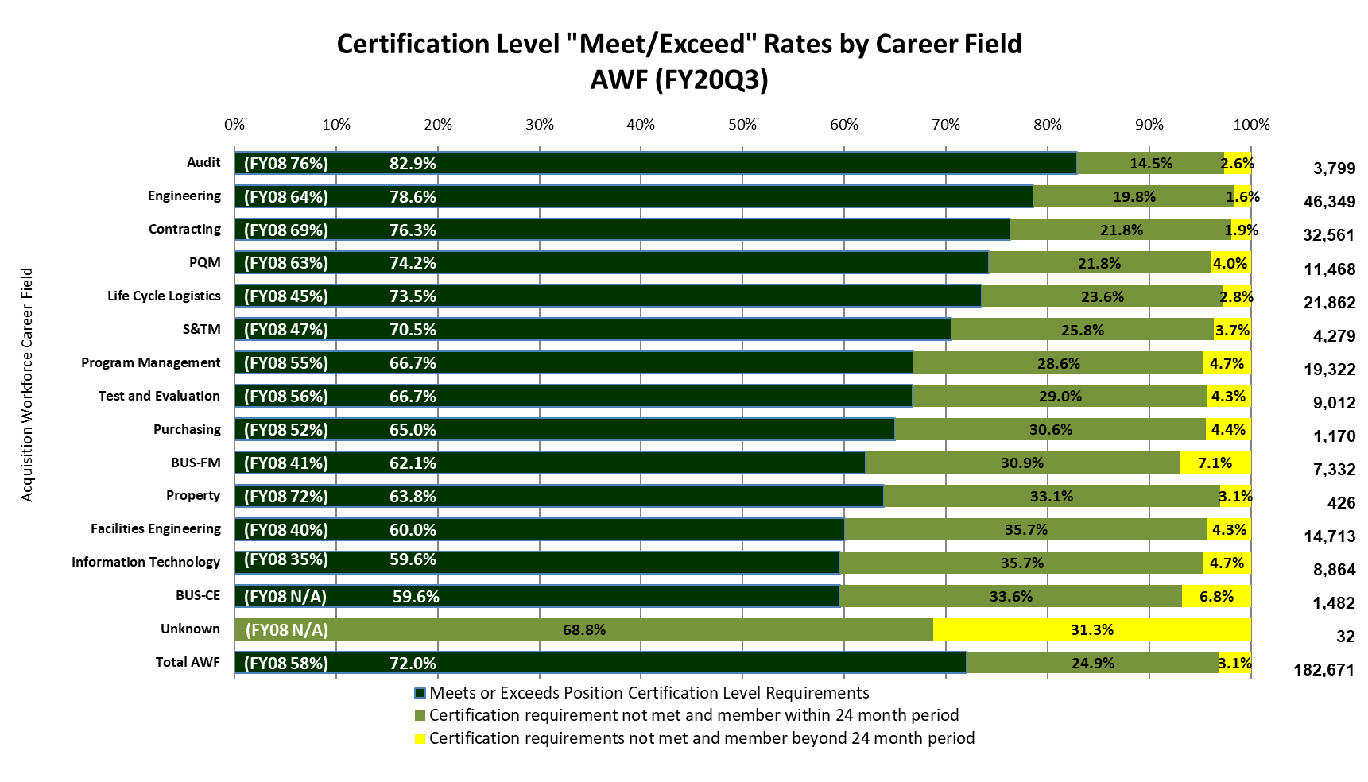
Business DAWIA Certification by Career Field
Data Source: A&S DataMart as of 30 June 2020

Slide 9
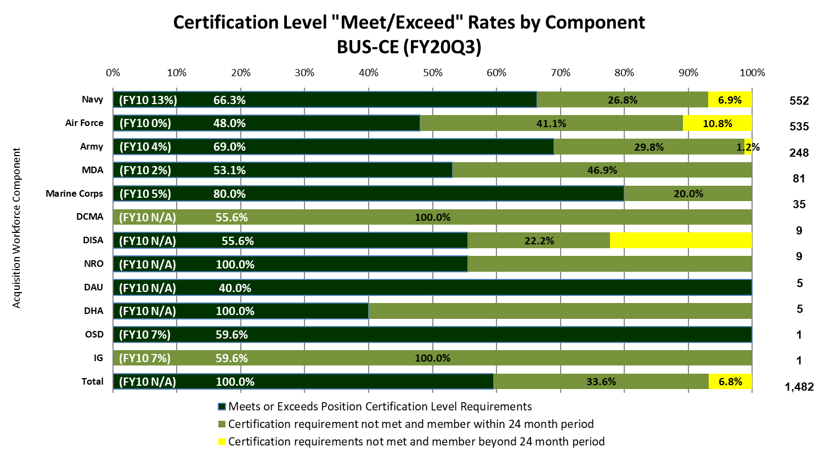
Business - CE DAWIA Certification by Component
Data Source: A&S DataMart as of 30 June 2020

Slide 10
Business - CE DAWIA Certification Matrix
+ Bench Strength
Data Source: A&S DataMart as of 30 June 2020

Slide 11
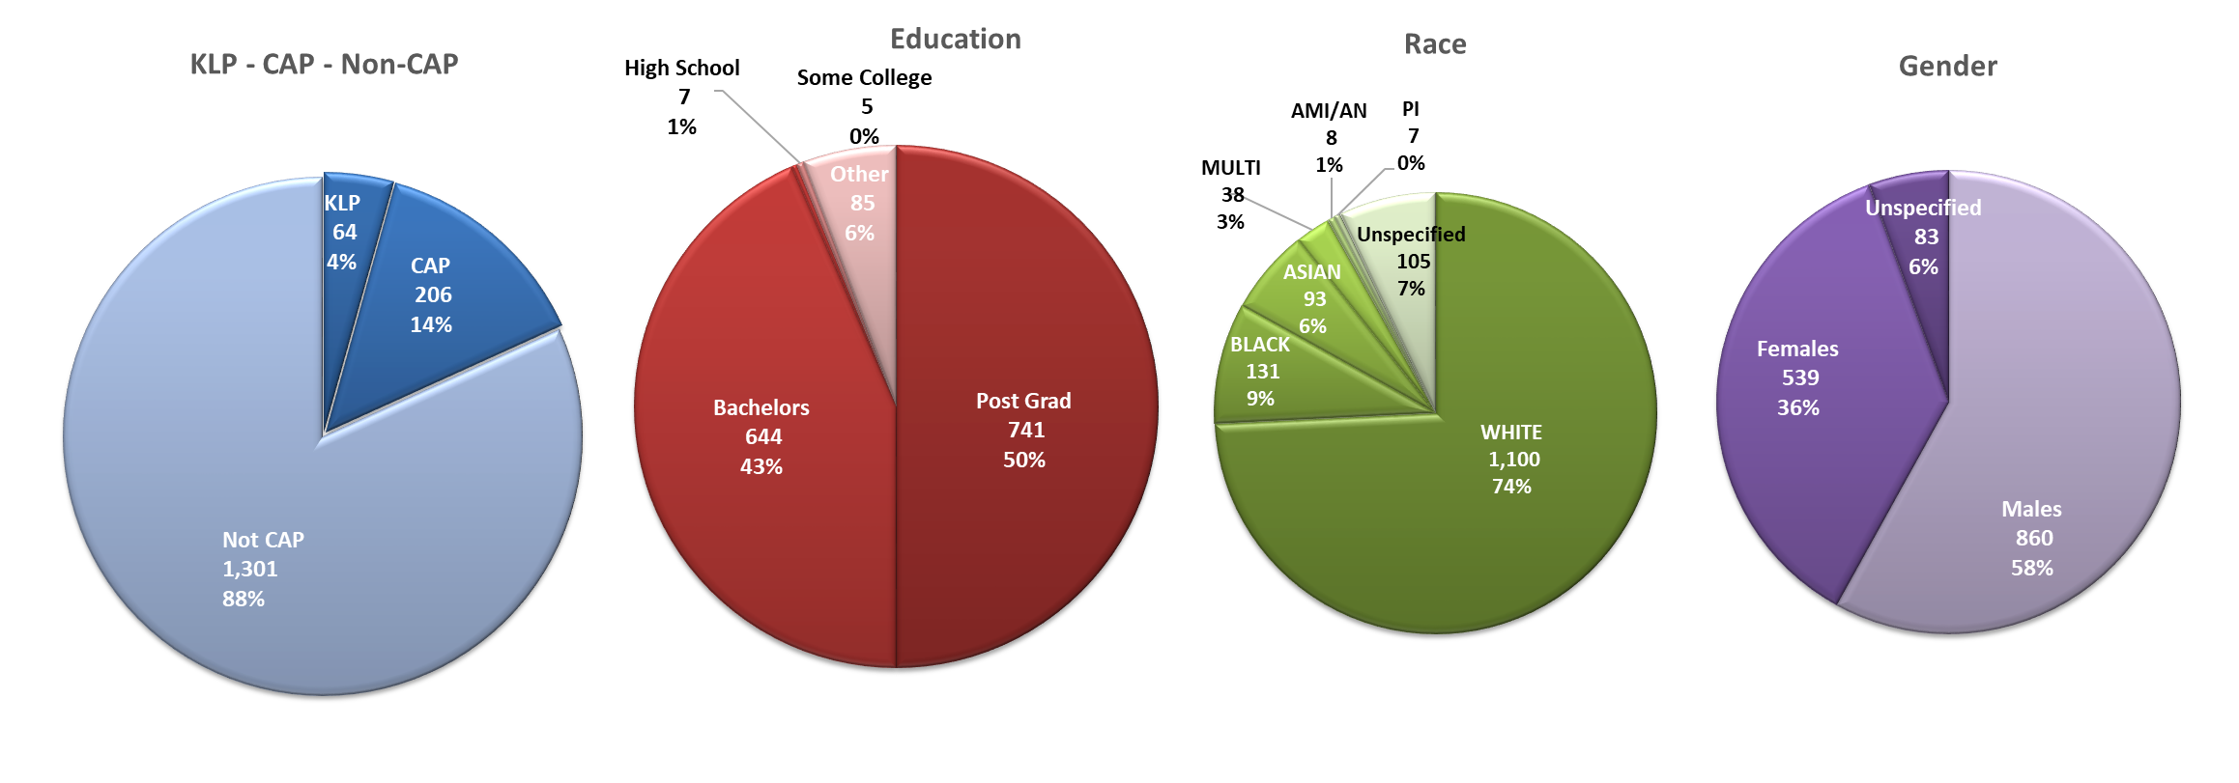
Business CE Demographics
Data Source: A&S DataMart as of 30 June 2020

Slide 12
Business CE Occupational Series
Data Source: A&S DataMart as of 30 June 2020

